Slide 1
WELCOME
WELCOME
WELCOME
WELCOME
WELCOME
WELCOME
WELCOME
WELCOME
WELCOME
WELCOME

Slide 2
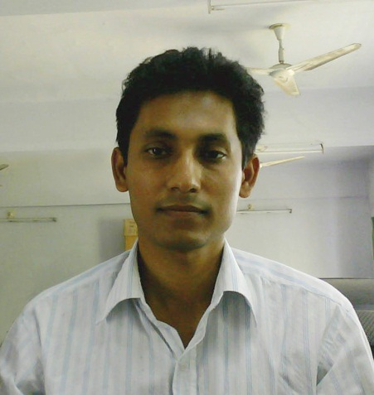
PRESENTER
Rasel
Assistant Teacher (Computer)
Charmugria Girls’ High School
Mobile: 01911096530
E-mail: rasel604@gmail.com

Slide 3
Class: Nine
ENGLISH 2ND PAPER
GRAMMAR
Flashback

Slide 4
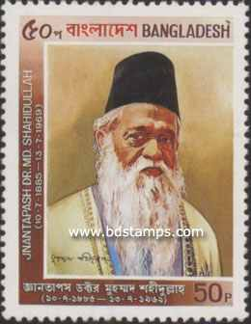


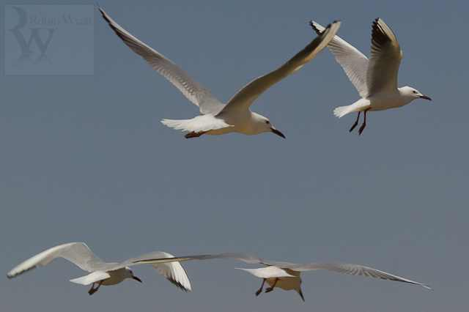
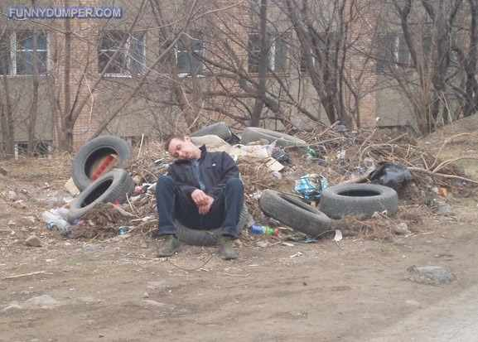
Look at the pictures
Riding a bicycle
Learned man
Flying Birds
Flashback
Tired/Sleeping

Slide 5
Burning Light
Flashback

Slide 6
PARTICIPLE
AND
GERUND
Flashback

Slide 7
OBJECTIVES
By the end of this lesson the students will be able to:
describe the structure of participle & gerund.
write the classification of participle.
use the different types of participle & gerund.
identify the difference of present participle & gerund.
make sentences with participle & gerund.
Flashback

Slide 8

PARTICIPLE
Verb+ing
Verb+ing
Verb+ing
=
(Verb + Adjective)
A barking dog seldom bites.
Verb(PP)
Verb(PP)
Verb(pp)
=
(Verb + Adjective)
A learned man is respected everywhere.
Flashback

Slide 9
KINDS OF PARTICIPLE
1. Present Participle
2. Past Participle
3. Perfect Participle
Flashback

Slide 10
1. PRESENT PARTICIPLE
Verb+ing
Verb+ing
=
(Verb + Adjective)
Verb+ing
Verb+ing
Verb+ing
A barking dog seldom bites.
A lying witness ought to be punished.
He kept me waiting.
Don’t shoot at the flying bird.
Flashback

Slide 11
2. PAST PARTICIPLE
Verb(P.P)
Verb+
Verb+en
Verb+
Verb+ed
Verb+t
Verb+
Verb+
Verb+en
ed
en
en
n
t
=
(Verb + Adjective)
Verb+
Verb+en
Verb+n
My father is a retired officer.
Mr. Kamal is a well known person here.
A burnt child dreads the fire.
It is my bounden duty.
Don’t sit on the broken chair.
Flashback

Slide 12
3. PERFECT PARTICIPLE
Having + Verb (past participle)
Having
V-3,
Past simple
Having finished his story, he went out.
Having learnt my lessons, he went to bed.
Having done shopping, he came home.
Having seen the snake, the boy cried out at the top of his voice.
Flashback

Slide 13
Uses of PARTICIPLE
Verb+ing
A drowning man catches at a straw.
I have read an interesting book.
Education is the most pressing need of our time.
The book is more interesting than that.
Seeing the bird, he shot it.
Flashback

Slide 14
Uses of PARTICIPLE
participle = Preposition
I went to Dhaka during the Winter vacation.
Do you know anything regarding the murder case?
Flashback

Slide 15
Uses of PARTICIPLE
very + Present Participle
It was a very thrilling film.
The story is very interesting.
much + Past Participle
I am much interested in this matter.
Flashback

Slide 16
GERUND
Verb+ing
Verb+ing
Verb+ing
=
(Verb + Noun)
Verb+ing
Swimming is a good exercise.
Sleeping by day is a bad habit.
Flashback

Slide 17
Uses of Gerund
1. Walking is good for health.
2. She likes reading poetry.
3. I am fond of singing.
1. Walking is good for health.
2. She likes reading poetry.
3. I am fond of singing.
2. She likes reading poetry.
3. I am fond of singing.
3. I am fond of singing.
1. Walking is good for health.
2. She likes reading poetry.
3.
1. Walking is good for health.
2. She likes reading poetry.
3. I am fond of singing.
Subject
Verb
(Verb+Noun)=Gerund
Verb
Object
(Verb+Noun)=Gerund
Preposition
Object
(Verb+Noun)=Gerund
Flashback

Slide 18



PRESENT PARTICIPLE Vs GERUND
Present Participle
Verb
Verb
Verb
Adjective
Adjective
Adjective
I saw a Swimming fish.
Gerund
Verb
Verb
Verb
Noun
Noun
Noun
Swimming is a good exercise.
Flashback

Slide 19
Noun
Verb
Adjective
Gerund
Participle
Flashback

Slide 20
Activity
Individual Works
Find out the Participles & Gerunds from the following sentences and compare them.
Answer:
I like reading newspapers.
(Gerund)
2. You should not get into a running train. (Present Participle)
3. We should not eat rotten food.
(Past Participle)
4. Having switched off the light, he went out. (Perfect Participle)
I like reading newspapers.
2. You should not get into a running train.
3. We should not eat rotten food.
4. Having switched off the light, he went out.
Flashback

Slide 21
Group works
Combine the sentences using Gerund or Participle
1. Bring me the flower. It is floating.
Bring me the
flower.
floating
Ans:
The child went to its mother
2. The child went to its mother. It was
dancing.
dancing
Ans:
3. He was tired of overwork. He sat down to rest.
Being
tired of overwork he sat
down to rest.
Ans:
Flashback

Slide 22
Assessment
1. Describe the classification of Participle.
2. Difference between present participle and
gerund.
3. Combine of sentences.
Flashback

Slide 23
Flashback
Look At the Pictures
Lesson Announce
Objectives
Participle
Use of Participle
Gerund
Difference between
Works
Assessment
Go
Light
Go
Go
Intr.
Kinds
P.P1
P.P2
P.P3
GO
GO
GO
Intr.
Use
Text
Circle
Individual
Groups
Home
Go
Thanks

Slide 24
HOME WORK
1. Define the following with examples:
  a. Past Participle.
  b. Present Participle.
  c. Verbal Noun.
2. Make statements with participle and gerund using following cues.
Clues | Statements
come/weep | Present participle
destroy/ rebuild | Past Participle
arrive/have | Perfect Participle
get/thank | Gerund
Flashback

Slide 25
Q & A
Flashback

Slide 26
Thank You
Flashback

Slide 27
PRESENTER
Rasel
Assistant Teacher (Computer)
Charmugria Girls’ High School
Mobile: 01911096530
E-mail: rasel604@gmail.com

Slide 28
Class: Nine
ENGLISH 2ND PAPER
GRAMMAR
Flashback

Slide 29
Look at the pictures
Riding a bicycle
Learned man
Flying Birds
Flashback
Tired/Sleeping

Slide 30
Burning Light
Flashback

Slide 31
PARTICIPLE
AND
GERUND
Flashback

Slide 32
OBJECTIVES
By the end of this lesson the students will be able to:
describe the structure of participle & gerund.
write the classification of participle.
use the different types of participle & gerund.
identify the difference of present participle & gerund.
make sentences with participle & gerund.
Flashback

Slide 33
PARTICIPLE
Verb+ing
Verb+ing
Verb+ing
=
(Verb + Adjective)
A barking dog seldom bites.
Verb(PP)
Verb(PP)
Verb(pp)
=
(Verb + Adjective)
A learned man is respected everywhere.
Flashback

Slide 34
KINDS OF PARTICIPLE
1. Present Participle
2. Past Participle
3. Perfect Participle
Flashback

Slide 35
1. PRESENT PARTICIPLE
Verb+ing
Verb+ing
=
(Verb + Adjective)
Verb+ing
Verb+ing
Verb+ing
A barking dog seldom bites.
A lying witness ought to be punished.
He kept me waiting.
Don’t shoot at the flying bird.
Flashback

Slide 36
2. PAST PARTICIPLE
Verb(P.P)
Verb+
Verb+en
Verb+
Verb+ed
Verb+t
Verb+
Verb+
Verb+en
ed
en
en
n
t
=
(Verb + Adjective)
Verb+
Verb+en
Verb+n
My father is a retired officer.
Mr. Kamal is a well known person here.
A burnt child dreads the fire.
It is my bounden duty.
Don’t sit on the broken chair.
Flashback

Slide 37
3. PERFECT PARTICIPLE
Having + Verb (past participle)
Having
V-3,
Past simple
Having finished his story, he went out.
Having learnt my lessons, he went to bed.
Having done shopping, he came home.
Having seen the snake, the boy cried out at the top of his voice.
Flashback

Slide 38
Uses of PARTICIPLE
Verb+ing
A drowning man catches at a straw.
I have read an interesting book.
Education is the most pressing need of our time.
The book is more interesting than that.
Seeing the bird, he shot it.
Flashback

Slide 39
Uses of PARTICIPLE
participle = Preposition
I went to Dhaka during the Winter vacation.
Do you know anything regarding the murder case?
Flashback

Slide 40
Uses of PARTICIPLE
very + Present Participle
It was a very thrilling film.
The story is very interesting.
much + Past Participle
I am much interested in this matter.
Flashback

Slide 41
GERUND
Verb+ing
Verb+ing
Verb+ing
=
(Verb + Noun)
Verb+ing
Swimming is a good exercise.
Sleeping by day is a bad habit.
Flashback

Slide 42
Uses of Gerund
1. Walking is good for health.
2. She likes reading poetry.
3. I am fond of singing.
1. Walking is good for health.
2. She likes reading poetry.
3. I am fond of singing.
2. She likes reading poetry.
3. I am fond of singing.
3. I am fond of singing.
1. Walking is good for health.
2. She likes reading poetry.
3.
1. Walking is good for health.
2. She likes reading poetry.
3. I am fond of singing.
Subject
Verb
(Verb+Noun)=Gerund
Verb
Object
(Verb+Noun)=Gerund
Preposition
Object
(Verb+Noun)=Gerund
Flashback

Slide 43
PRESENT PARTICIPLE Vs GERUND
Present Participle
Verb
Verb
Verb
Adjective
Adjective
Adjective
I saw a Swimming fish.
Gerund
Verb
Verb
Verb
Noun
Noun
Noun
Swimming is a good exercise.
Flashback

Slide 44
Noun
Verb
Adjective
Gerund
Participle
Flashback

Slide 45
Activity
Individual Works
Find out the Participles & Gerunds from the following sentences and compare them.
Answer:
I like reading newspapers.
(Gerund)
2. You should not get into a running train. (Present Participle)
3. We should not eat rotten food.
(Past Participle)
4. Having switched off the light, he went out. (Perfect Participle)
I like reading newspapers.
2. You should not get into a running train.
3. We should not eat rotten food.
4. Having switched off the light, he went out.
Flashback

Slide 46
Group works
Combine the sentences using Gerund or Participle
1. Bring me the flower. It is floating.
Bring me the
flower.
floating
Ans:
The child went to its mother
2. The child went to its mother. It was
dancing.
dancing
Ans:
3. He was tired of overwork. He sat down to rest.
Being
tired of overwork he sat
down to rest.
Ans:
Flashback

Slide 47
Assessment
1. Describe the classification of Participle.
2. Difference between present participle and
gerund.
3. Combine of sentences.
Flashback

Slide 48
Flashback
Look At the Pictures
Lesson Announce
Objectives
Participle
Use of Participle
Gerund
Difference between
Works
Assessment
Go
Light
Go
Go
Intr.
Kinds
P.P1
P.P2
P.P3
GO
GO
GO
Intr.
Use
Text
Circle
Individual
Groups
Home
Go
Thanks

Slide 49
HOME WORK
1. Define the following with examples:
  a. Past Participle.
  b. Present Participle.
  c. Verbal Noun.
2. Make statements with participle and gerund using following cues.
Clues | Statements
come/weep | Present participle
destroy/ rebuild | Past Participle
arrive/have | Perfect Participle
get/thank | Gerund
Flashback

Slide 50
Q & A
Flashback

Slide 51
Thank You
Flashback

